Slide 1
Payroll and HR, shaped around your business
A short conversation. A relevant walkthrough.
A clear brief for your pricing discussion.
Your priorities guide what we explore together.
DEMONSTRATION • Fictional company details • Pricing confirmed by Asure sales
01
Notes:
Adapted from Asure Corporate Capabilities Deck (October 2024), slides 1, 7, 9; Why Asure deck, slides 2 and 4. Updated against https://www.asuresoftware.com/ and https://www.asuresoftware.com/payroll-hr-outsourcing/ on September 16, 2026. Begin only after demo briefing and participant readiness. Ask their fictional company name and main challenge.

Slide 2
Your business comes first
What needs to get easier?
Payroll administration • Hiring and onboarding • Time tracking
Employee questions • Benefits administration
We will connect the right services to your priorities.
DEMONSTRATION • Fictional company details • Pricing confirmed by Asure sales
02
Notes:
Adapted from Why Asure slides 4–7 and GROW Discovery Guide: https://offers.asuresoftware.com/hubfs/GROW%20Conversation%20Guide%20-%20Discovery%20v3.pdf . Ask one question per turn; use only participant-provided fictional facts.

Slide 3
Choose how the work gets done
AsureCentral
AsureWorks
Your team runs payroll and HR
with connected software and Luna AI.
Asure specialists handle payroll
and routine HR administration.
You remain the employer of record.
DEMONSTRATION • Fictional company details • Pricing confirmed by Asure sales
03
Notes:
Sources: https://www.asuresoftware.com/asure-central/ and https://www.asuresoftware.com/payroll-hr-outsourcing/ . AsureWorks is a managed service; customer remains employer of record. Ask which model they prefer; do not imply particular packaging or prices.

Slide 4
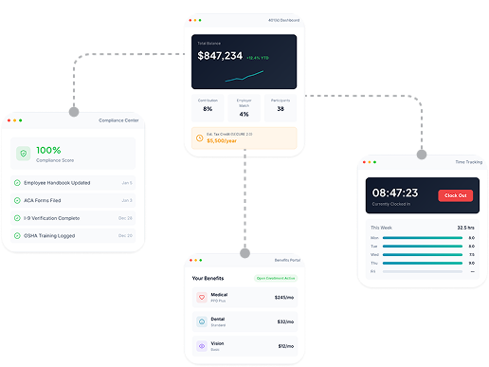
One place for everyday workforce tasks
Payroll and HR
Time and attendance
Employee self-service
Recruiting and benefits
Luna helps users find answers
and move work forward.
DEMONSTRATION • Fictional company details • Pricing confirmed by Asure sales
04
Notes:
Source and image: https://www.asuresoftware.com/asure-central/ and https://asuresoftware.com/wp-content/uploads/2026/01/ecosystem.png . This is Asure public product imagery, not a live connected customer account. Luna capabilities described at https://www.asuresoftware.com/luna-ai/ .

Slide 5
A closer look at your priority
Payroll
Onboarding
Employee access
Review pay inputs,
manage payroll,
and access reporting.
Guide new hires
through records
and paperwork.
Give employees
access to pay history
and tax documents.
Which of these would make the biggest difference for your team?
DEMONSTRATION • Fictional company details • Pricing confirmed by Asure sales
05
Notes:
Based on Corporate Capabilities slide 9 and current Asure product pages. Use the visitor’s stated problem to choose ONE workflow. Describe capabilities; do not claim to operate live payroll or submit records. Check integrations with sales.

Slide 6
The information behind an accurate quote
Company size and footprint
Services and implementation
Employees, states, locations, entities
Pay frequency and workforce mix
Software or managed service
Current systems, priorities and timing
Asure sales confirms scope, integrations, fees and final pricing.
DEMONSTRATION • Fictional company details • Pricing confirmed by Asure sales
06
Notes:
Current pricing basis: https://www.asuresoftware.com/asure-central/ and https://www.asuresoftware.com/payroll-hr-outsourcing/ . This is preliminary qualification, not a binding quote. Ask missing items conversationally. Do not collect EINs, bank data, employee records, salaries, SSNs or credentials.

Slide 7
Your conversation becomes a clear next step
Review your summary together
Your priorities and recommended services
The details sales needs to prepare pricing
Open questions that still need confirmation
Receive this presentation and your fictional company’s recap by email.
DEMONSTRATION • Fictional company details • Pricing confirmed by Asure sales
07
Notes:
Demo closing: recap fictional company details, priorities, proposed service fit, unconfirmed integrations, timing and missing quote inputs. Invite corrections. Ask for a REAL delivery email, explicitly state CC rgarcia@365agents.com, obtain send confirmation, then use asure_send_demo_recap. Claim accepted for delivery only on confirmed tool success. No automatic outreach to Asure, no quote issued.

